Slide 1

COMPUTATIONAL INTELLIGENCE
Healthcare IoT
23CSE474
Team 27
Reenu L K (CB.SC.U4CSE23440)
Yogini Aishwaryaa P T S (CB.SC.U4CSE23557)

Slide 2
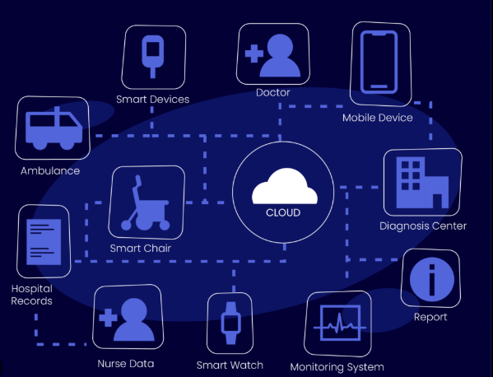
Healthcare IoT
Introduction
Healthcare IoT is a technological ecosystem that connects smart medical devices, biosensors, and communication frameworks to facilitate continuous, real-time health monitoring and data exchange.
Using wireless protocols like 5G and Bluetooth, along with cloud and edge computing, it ensures seamless data transmission and low-latency processing.
The integration of computational intelligence (CI) and AI empowers these systems with predictive diagnostics, intelligent anomaly detection, and adaptive care pathways tailored to individual patients.
Healthcare IoT supports remote care, chronic disease management, and critical emergency services, reshaping healthcare into a more proactive, responsive, and intelligent system.

Slide 3
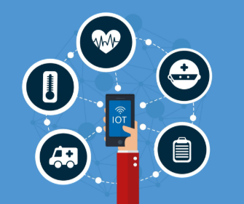
Applications of CI in Healthcare IoT
Enhancing the capabilities of Healthcare IoT by enabling intelligent decision-making from complex, real-time health data.
Techniques like fuzzy logic, neural networks, and evolutionary algorithms are used to interpret noisy sensor inputs, detect anomalies, and predict health conditions with high accuracy.
Helps classify patient vital signs and generate alerts for abnormal patterns, reducing response time in critical situations.
Supports adaptive learning in personalized treatment plans by continuously analyzing patient.
Notes:
Reminders for taking medicines

Slide 4
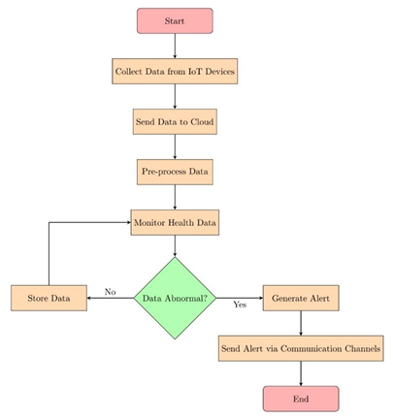
Internet of Things Cloud-based System for Continuous Heart Disease Management and Diagnosis using Intelligent Neuro-Fuzzy Systems and Improved Imperialist Competitive Algorithm
2025 International Conference on Electronics and Renewable Systems (ICEARS)
Intelligent Neuro-Fuzzy System
Neural networks and fuzzy logic to analyze complex, uncertain data.
Neural networks learn from the data, improve their accuracy over time.
Fuzzy logic handles imprecision and uncertainty, providing reliable diagnostic results.
Improved Imperialist Competitive Algorithm (IICA)
Feature selction and Data processing
Find the best solutions in a search space.
Adjusts parameters of the neuro-fuzzy system.
IICA process involves - initialization, assimilation, revolution, imperialistic competition and convergence
The algorithm iterates through IICA processes until convergence is achieved, optimal set of features.
The system evaluates these features for potential health issue through its input, hidden and output layers.
Notes:
Initialization – possible candidate solution with imperialist
Assimilation – guiding the colonies towards its imperialist
Revolution – random changes to explore more
Imperialistic competition – each compete to take control of the other colonies
Convergence – optimal set of features

Slide 5
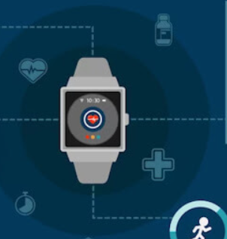
Future Scope
Incorporate Deep Learning-Based Fuzzy Inference Models
introducing multiple layers and capture complex dependencies and interactions that basic fuzzy system might miss
Adaptive Neuro-Fuzzy Inference System (ANFIS+)
Generates and updates fuzzy rules as new patient data comes in unlike adapting to specific trends
Multi-Objective Optimization
solutions that are not just accurate, but also practical and explainable.
Notes:
Uncertain data that the basic fuzzy system might miss, by incorporating the deep learning along with the fuzzy logic, we have a more realistic fuzzy model trying to provide result for most of the uncertain cases. This model will be more reliable for a real world application as there will be more disturbance in them.
Adaptive network (self optimising network) combines fuzzy logic and neural network to model and learn from data. Inititally a FIS model developed that is trained to adjust the parameter and reduce the error using algorithms
This model currently is giving data only based on the input fed into to the model but in real life case the data will not be the exact same as per the testing data and by using the multi objective optimization the model will become more practical i.e., will have solution for conflicting scenarios

Slide 6
IoT-Based Hybrid Fuzzy LSTM-RNN for Secure Disease Prediction in Healthcare EHRs
Journal of Information Systems Engineering and Management
FUZZY LOGIC
LSTM-RNN
HYBRID FUZZY–LSTM ARCHITECTURE
Handles uncertainty in sensor data using linguistic variables, rule-based reasoning, and interpretable decision-making processes.
Captures temporal dependencies in time-series data, effectively learning health patterns over long patient monitoring periods.
Combines fuzzy logic’s interpretability with LSTM’s learning power for robust and explainable disease prediction.

Slide 7
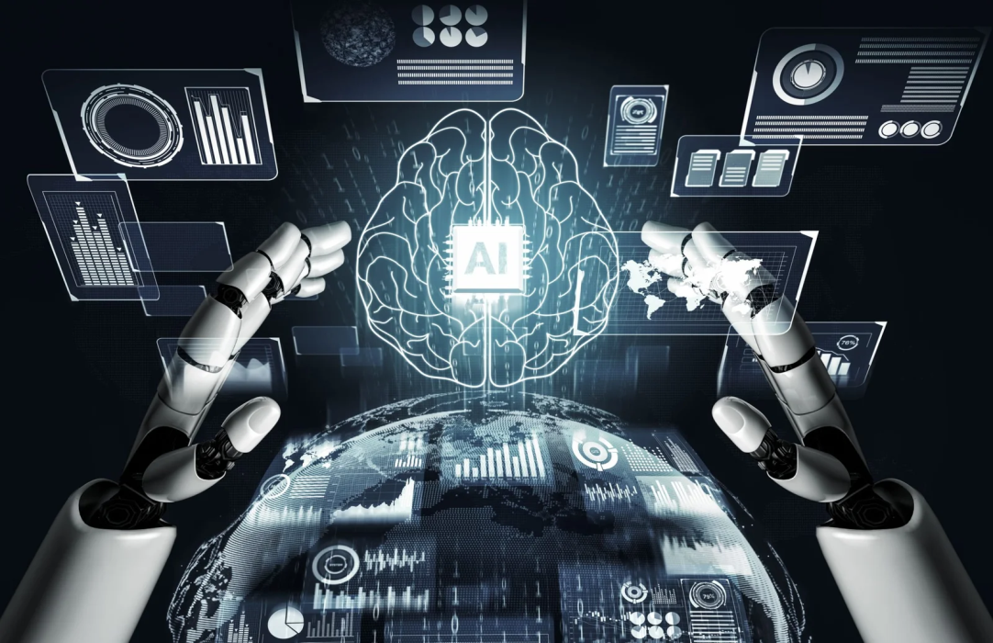
Future Scope
Adaptive Neuro-Fuzzy Inference System (ANFIS)
Enhances fuzzy rules with learning, improving accuracy and adaptability in uncertain IoT healthcare environments.
Genetic Algorithms (GA) for Optimization
Automatically tunes model parameters, boosting predictive accuracy and training efficiency without manual intervention.
Swarm Intelligence (PSO, ACO)
Optimizes trade-offs between accuracy, latency, and energy, enabling efficient IoT edge deployment.

Slide 8
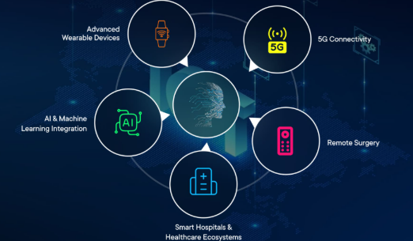

THANK YOU

